Slide 1


OVERVIEW OF THE RESPIRATOR DISEASES SURVEILLANCE IN ZAMBIA
Paul Simusika
On behalf of the National Influenza Center and ZNPHIRL Team -Zambia

Slide 2
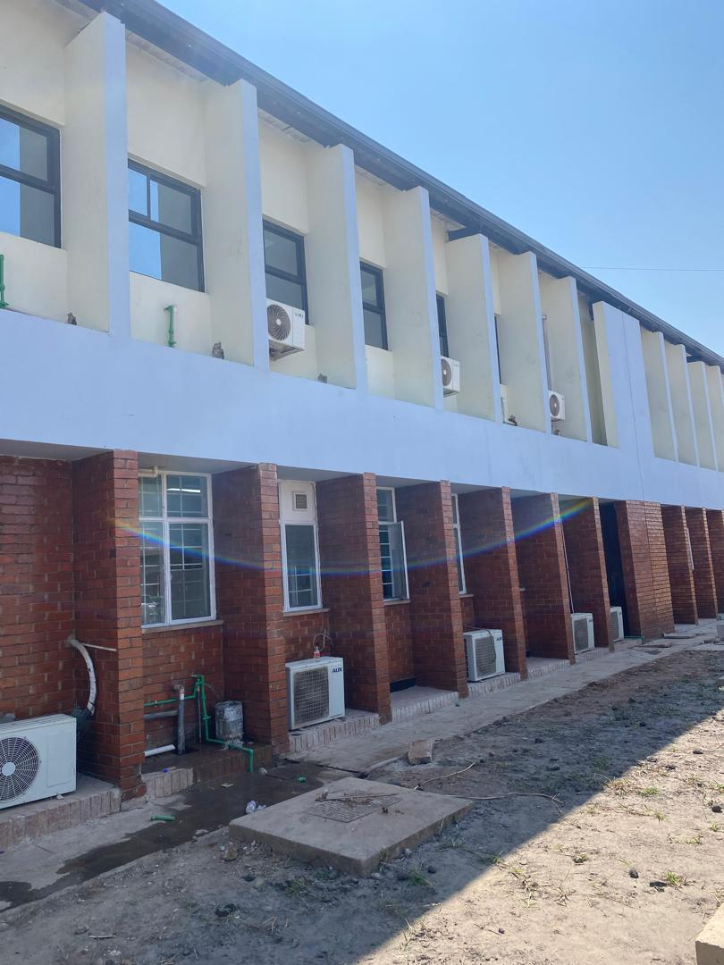
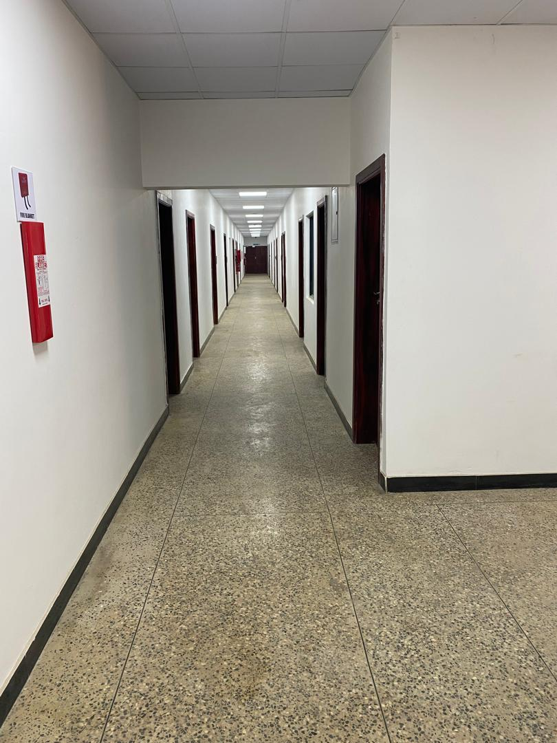
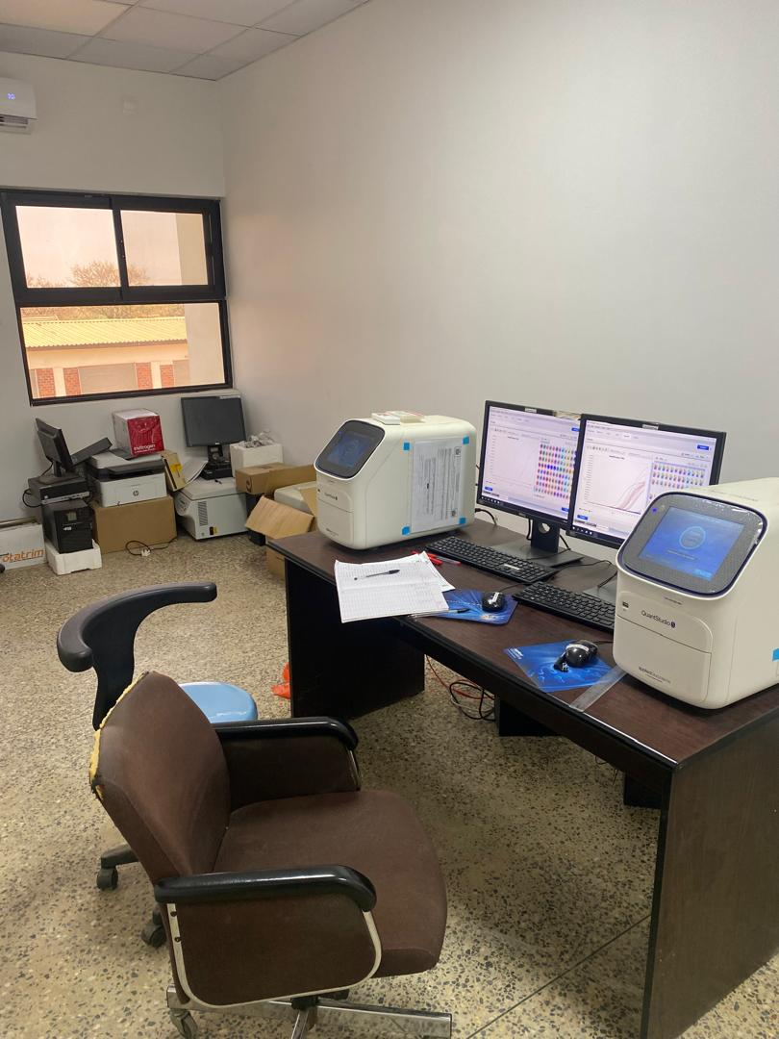

ZAMBIA PRESENTATION

Slide 3
PRESENTATION OUTLINE
Overview of the National Surveillance Systems for respiratory illness
ILI/SARI Surveillance
Extended SARI Surveillance
Laboratory and diagnostic Capacity
Genomic surveillance
Summary 2025 season
Operational Challenges and logistical challenges

Slide 4
BACKGROUND OF THE SARI/ILI SYSTEM IN ZAMBIA
The disease surveillance system was designed and developed around 2008 according to generic WHO guidelines.
It involves collection of data and clinical specimens from patients identified in selected sentinel health facilities across the country including:
out-patients with mild respiratory symptoms or influenza-like illness (ILI cases)
patients admitted with severe acute respiratory illness (SARI cases)
The specimens are tested for respiratory viruses – primarily influenza and other respiratory viruses
In 2015, the UTH Virology Laboratory was recognized by the WHO as a National Influenza Center (NIC), and thus became a member of the Global Influenza Surveillance and Response System (GISRS)
2020 detected the first case of SARS-COV-2 in Zambia

Slide 5
OBJECTIVES OF ILI/SARI SURVEILLANCE SYSTEM
Tracking circulating seasonal viruses and feeding this information into the global influenza and other disease surveillance systems
Detecting new pathogen strains capable of causing a pandemic
Determining characteristics of influenza and other respiratory infectious diseases
Collecting data useful for guiding policy such as burden-of-disease estimates, or assessment of the effectiveness of interventions to prevent ILI, SARI and resulting mortality

Slide 6
SARI/ILI SENTINEL SURVEILLANCE SYSTEM IN ZAMBIA
Target population: | General population (all ages) presenting to selected health facilities (sentinel sites)
Case definitions : | ILI = fever + cough + ≤ 10 days duration SARI = ILI + hospitalization PUI (person under investigation) = SARI + exposure to HPAI risk Standard Extended SARI case definition (child hospitalised with cough, shortness of breath or apnea in the past 10 days)
Sampling: | 5 ILI per day All SARI cases
Lab testing: | Influenza and subtyping A – H1N1 pandemic; H3N2; H5; H7 OR B – Yamagata; Victoria SARS Cov 2 RSV Other Respiratory Viruses TAT ~ 5 days
Reporting: | Weekly surveillance reports shared with ZNPHI and other stakeholders and uploaded to FluNET/FluID

Slide 7
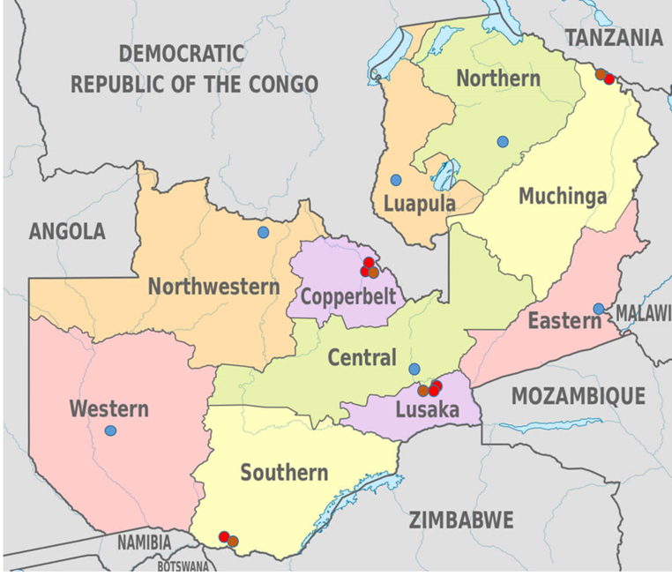
HEALTH FACILITIES SERVING AS SENTINEL SITES

Slide 8
NIC /ZNPHRL LABORATORY CAPACITIES
EQUIPMENT
7 Quanti studio
4 Automated extractor
1 Fluid Handler Hamilton
2 Gel Electrophoresis
Available diagnostic/Methods
Multiplex PCR for respiratory viruses
RT PCR FOR FLUSARS/RSV
26 Pathogens detected using Multiplex
e.g
Klebsiella pneumonia, Influenza B ,Mycoplasma pneumonia, Parainfluenza 1, Parainfluenza 2,Parainfluenza 4, Enterovirus, Human metapneumovirus A/B, Influenza A, Parainfluenza 3, Bocavirus, Rhinovirus, Coronavirus 229E, Pandemic H1N1, Bordetella pertussis, Moraxella catarrhalis, Influenza C
Haemophilus influenzae type B, Pneumocystis jirovecii, Streptococcus pneumonia, Staphylococcus aureus, Legionella pneumophila, Coronavirus OC43, Coronavirus NL63 Coronavirus HKU1
Notes:
Klebsiella pneumoniae (Hemolysin gene)
Influenza B
Mycoplasma pneumoniae (Adhesin P1)
Parainfluenza 1 (HN gene)
Parainfluenza 2 (N gene)
Parainfluenza 4 (F glycoprotein)
Enterovirus (5 ‘UTR)
Human metapneumovirus A/B (Nucleoprotein
Influenza A (MP2 gene)
Parainfluenza 3 (HN gene)
Bocavirus (NP1 gene)
Rhinovirus (5 ‘UTR)
Coronavirus 229E (N gene)
Pandemic H1N1
Salmonella enterica (TTR Site)
Bordetella pertussis (IS481)
Moraxella catarrhalis (COP B)
Influenza C (M Gene)
Haemophilus influenzae type B
Pneumocystis jirovecii (mt-LSU RNA)
Streptococcus pneumoniae (Lyt A)
Staphylococcus aureus (Nuc A)
Legionella pneumophila (MIP)
Coronavirus OC43 (N gene)
Coronavirus NL63 (N gene)
Coronavirus HKU1 (1ab polyprotein)

Slide 9
NIC /ZNPHRL SEQUENCING CAPACITIES
EQUIPMENT
3 ONT
3 Illumina sequencers
2 Automated extractor
4 Qubit
3 Conversation PCR
Bioinformatics Resources
1. High Powered Laptop =2
2. Server=2
Bioinformatic tools
1. Geneious Prime, BaseSpace,
2. Open-source tools; next strain, etc
3. Mira

Slide 10
SUMMARY OF 2025 SEASON

Slide 11
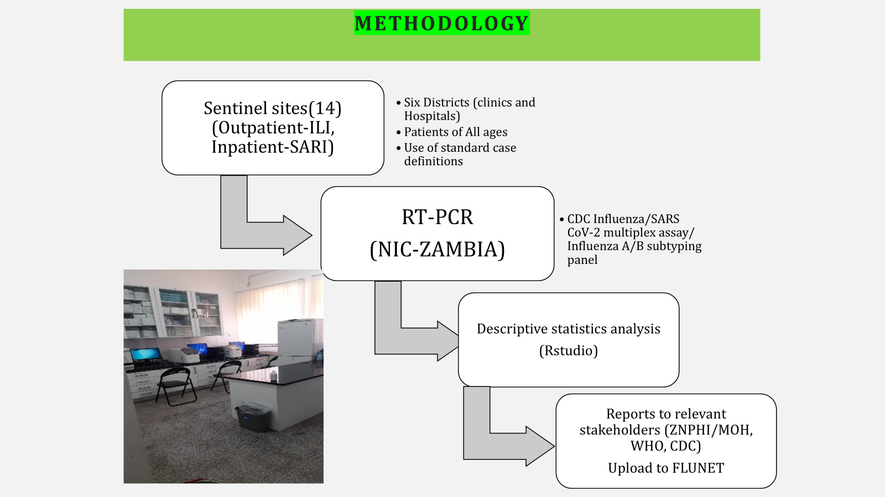
WORKFLOW SUMMARY

Slide 12
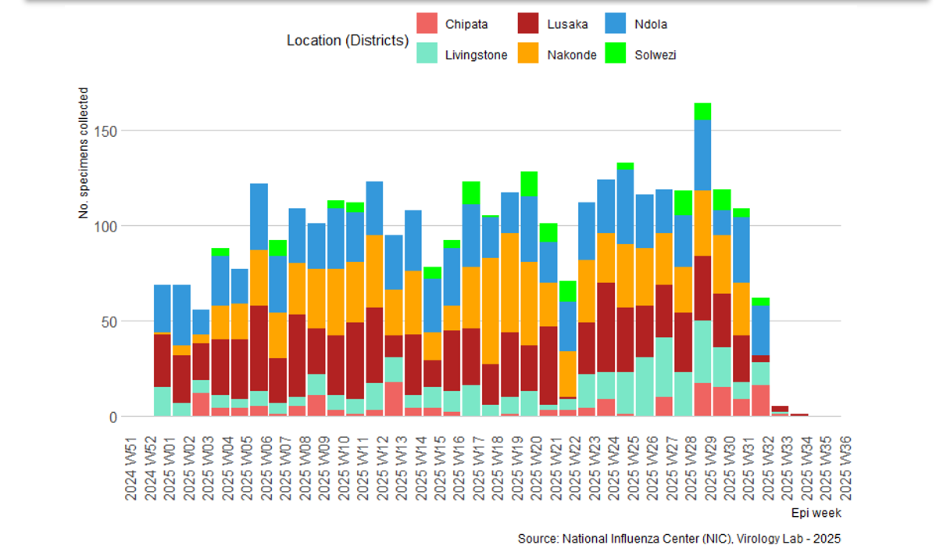
ILI/SARI CASES INVESTIGATED IN THE CURRENT 2025 SEASON

Slide 13
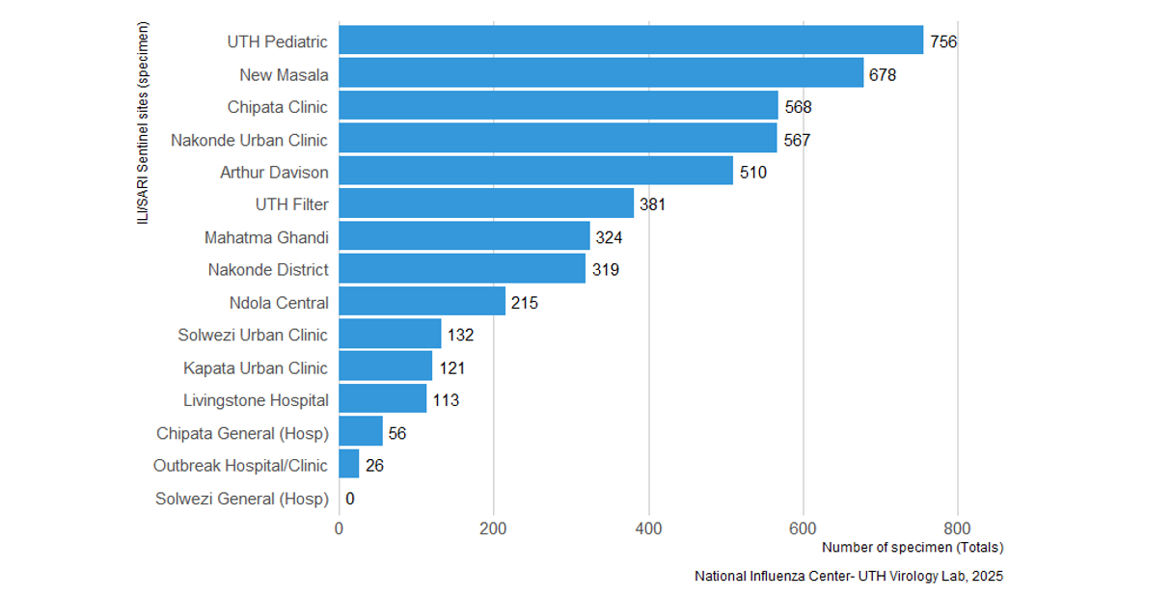
SPECIMENS COLLECTED IN 2025 SEASON

Slide 14
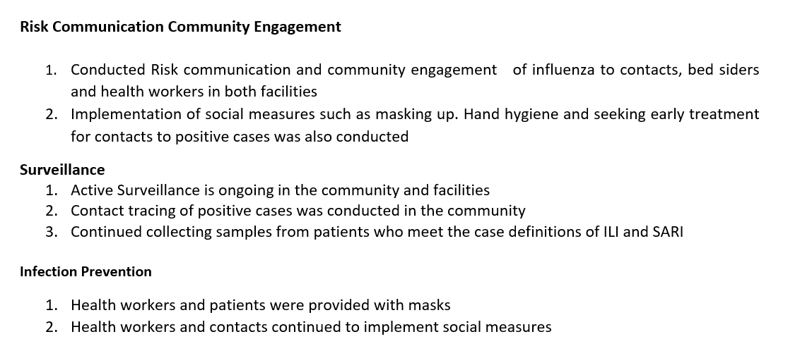
ILI/SARI SUSPECTED OUTBREAK SAMPLES
# | Location | Samples investigated | Common Pathogen detected
1 | Luangwa Boarding School _Eastern Province | 34 | H3N2
2 | Chipangali Boarding School_ Eastern Province | 105 | H3N2
3 | Mwense Boarding School_ Luapula Province | 8 | H3N2

Slide 15
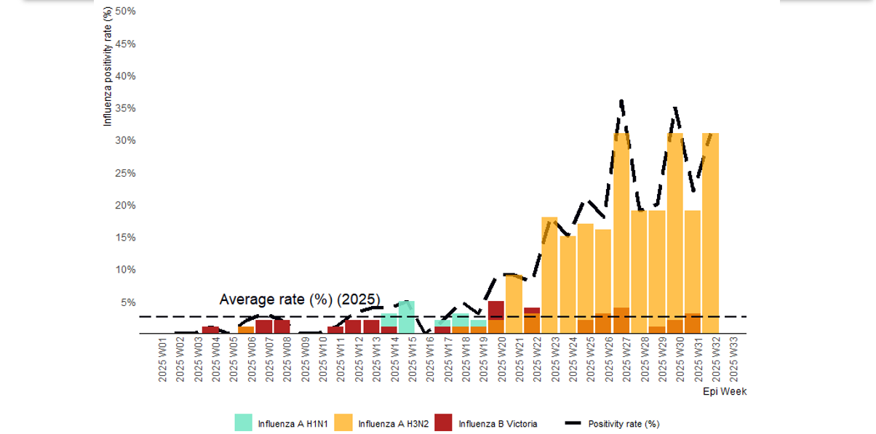
DISTRIBUTION OF INFLUENZA CASES IN 2025

Slide 16
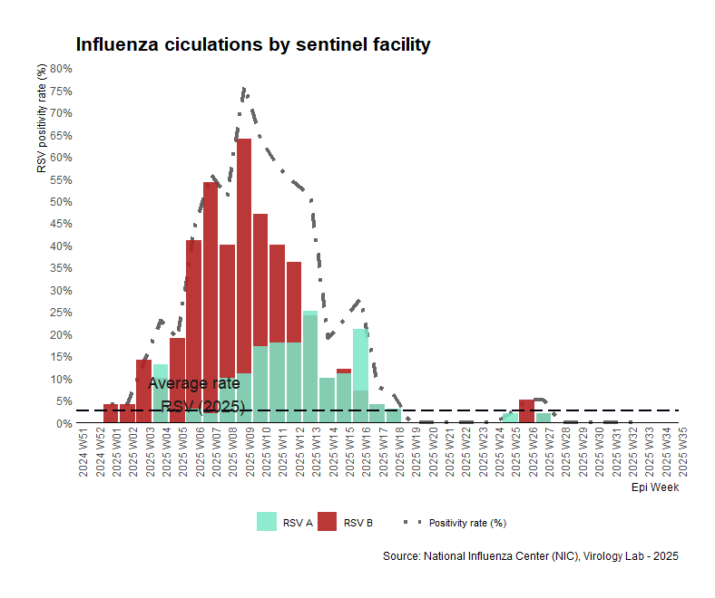
DISTRIBUTION OF RSV CASES IN 2025

Slide 17
INFLUENZA SEVERITY (SARI) THRESHOLD MONITORING

Slide 18
INFLUENZA TRANSMISSIBILITY(ILI) THRESHOLD MONITORING

Slide 19
GENOMIC SURVEILLANCE

Slide 20
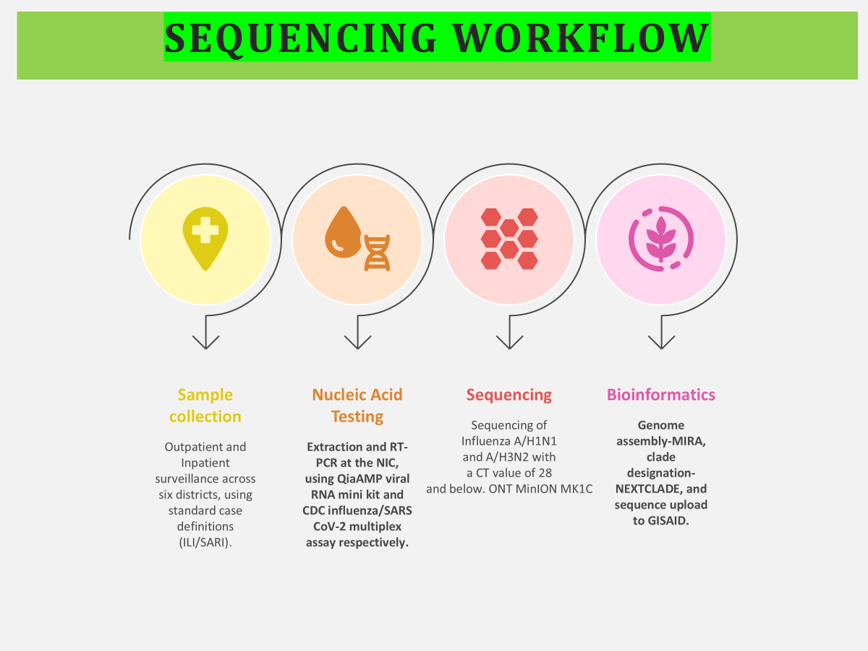
METHODOLOGY

Slide 21
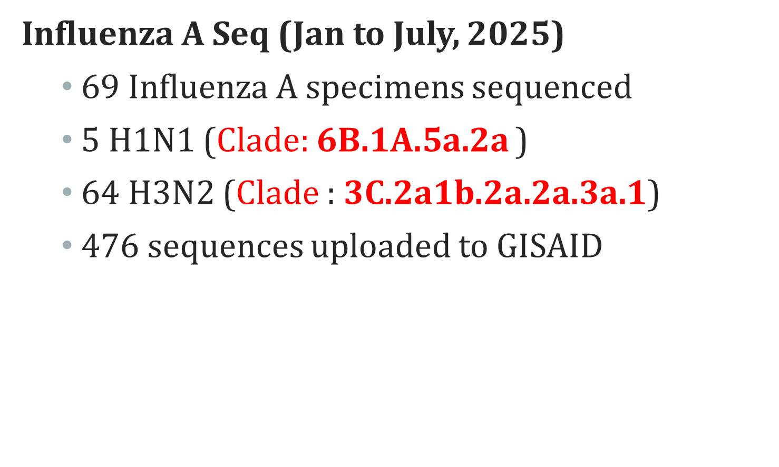
SEQUENCING RESULTS 2025

Slide 22
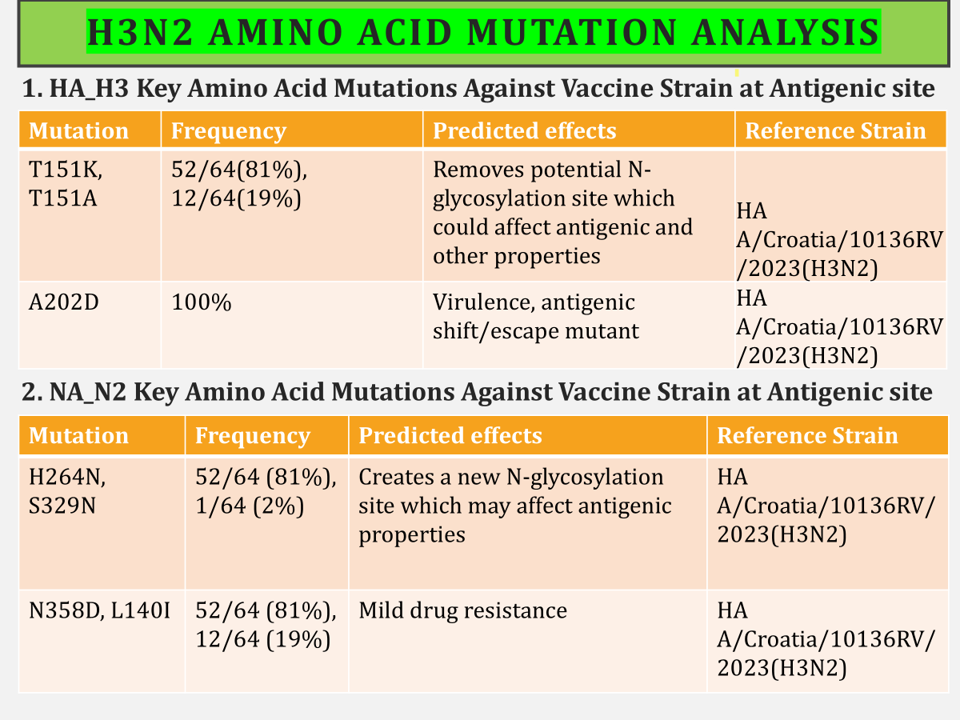
SEQUENCING RESULTS 2025

Slide 23
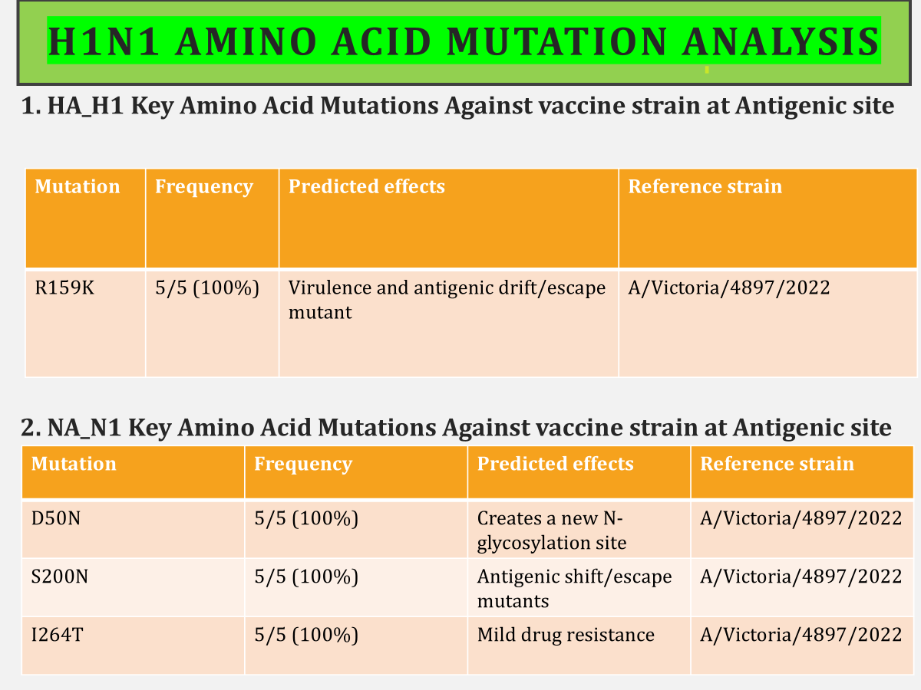
SEQUENCING RESULTS 2025

Slide 24
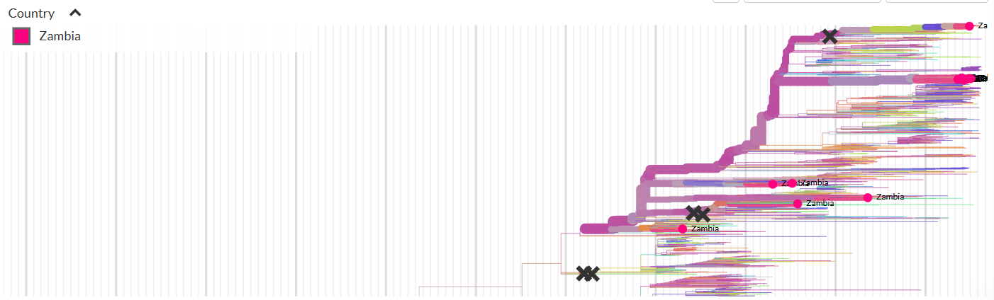
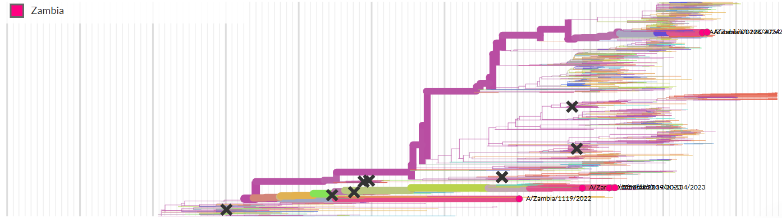
SEQUENCING RESULTS 2025
HINI 2009
H3N2

Slide 25
CHALLENGES
Surveillance is costly and relies on US CDC Support
Limited supply of reagents for multiplex PCR testing/IRR allocation?
Absence of community practice in respiratory genomic surveillance
Lack of trained bioinformatician (Intermediate skills available)
Flongle cells have a short life cycle

Slide 26
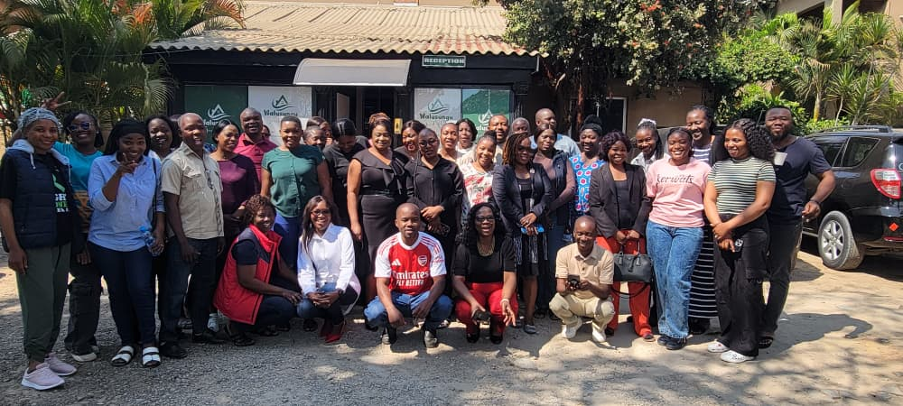
Thank you

